Slide 1



Attendance
& Face Recognition
System
Using Machine Learning and Deep Learning
Jayant Jonathan Stanley
Divyansh Tiwari
Ishita Jaiswal
Ankit Singh

Slide 2

Mentors
Dr. Vijay Kumar Dwivedi
HOD CS/IT
Mr. Rajiv Dixit
Assistant Professor CS
Jayant Jonathan Stanley
Roll No. 1801010056
Divyansh Tiwari
Roll No. 1801010042
Members
Ishita Jaiswal
Roll No. 1801010052
Ankit Singh
Roll No. 1801010016

Slide 3
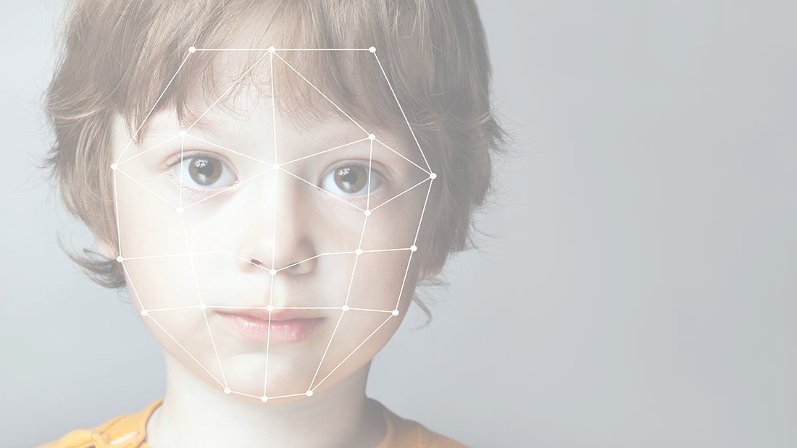


INTRODUCTION
About the Project
The system is developed for deploying an easy and a secure way of taking down attendance. The software first captures an image of all the authorized persons and stores the information into database. The system then stores the image by mapping it into a face coordinate structure.
Next time whenever the registered person enters the premises the system recognizes the person and marks his attendance along with the time.
The idea is to use machine learning to create an attendance system using facial recognition.

Slide 4

Aim
The aim of the project is to create a system capable of marking attendance and capturing other details of the subject such as time of entry, granting authorization and creating a log, all using facial recognition.

Slide 5
OBJECTIVES
The software can be used for security purposes in organizations and in secured zones.
The software stores the faces that are detected and automatically marks attendance.
The system is convenient and secure for the users.
It saves their time and efforts.
Face recognition is one of the few biometric methods that possess the merits of both high accuracy and low intrusiveness.
Possible Applications & Advantages

Slide 6

The system don’t recognize properly in poor light so may give false results.
It can only detect face from a limited distance.
Differently posing – there could be images of the same person with different face angles.
Confusing between similar looking people
It is diffucult to train the model and takes a considerable amount of time.
Challenges

Slide 7
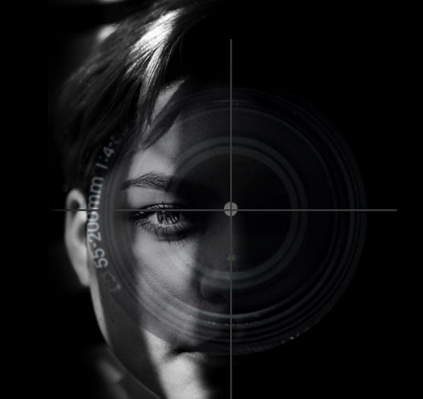
Steps in Recognition
A Face recognition algorithm can extract features from a face image namely positions of forehead, eyes, nose, mouth, chin, jaws. There are 68 specific points (called landmarks) that exist on every face.
This information is fed to the feature vector that has already been pre-trained from previous test data.
The next step is to match these encoding with the nearest possible image from a stored database.
The captured frames will be matched against the existing database images and if the match is found then it’ll store it in a CSV file which acts as an Attendance Register.

Slide 8


Major
Modules
Information Gathering / Planning
Model Design
Model Training / Database Connectivity
Model Testing and Review
Frontend & Deployment

Slide 9

Tools
Tensorflow
OpenCV
Google Colab
Django/Flask
Cascade Classifier
Keras
Pandas
Techniques
Facial Recognition
Convolutional Neural Network (CNN)
Transfer Learning
Computer Vision
Classification Models

Slide 10
FACE RECOGNITION & ATTENDENCE SYSTEM
Final Year Project Gantt Chart
Tasks
Month 1
Month 2
Month 3
Month 4
Data Collection and Data Wrangling
Model and Architecture Design
Model Training / Database Connectivity
Model Testing and Review
Frontend & Deployment

Slide 11

Thanks

